Slide 1


Daniel Eduardo López
July 27, 2022

Slide 2

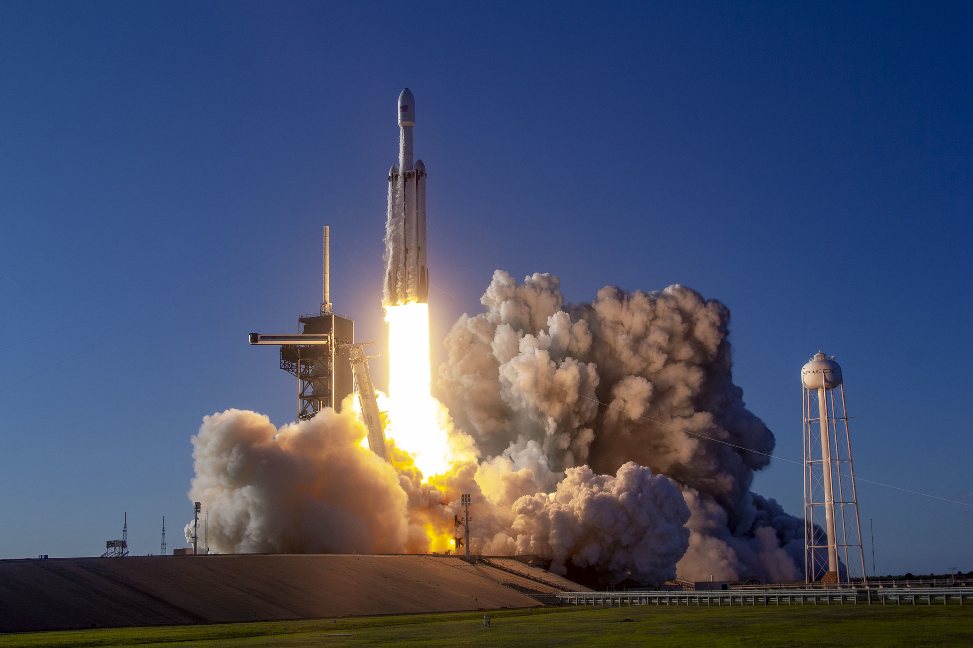
Outline
Executive Summary
Introduction
Methodology
Results
Conclusion
Appendix

Slide 3
Executive Summary
By using Python 3 and its libraries, historical data of Falcon 9 launches from 2010-04-06 to 2020-06-12 was retrieved through calls to the SpaceX's API and web scraping to the Wikipedia's article on List of Falcon 9 and Falcon Heavy launches.
Data was wrangled and explored through SQL queries, visualization and dashboarding, allowing to identify that SpaceX has a success rate of about 80%; KSC LC-39A is the launch site with the highest number of successful missions, whereas VAFB SLC-4E is the one with the lowest; ES-L1, GEO, HEO and SSO were the orbit types with the highest success rates (100%) but with a small number of missions; VLEO was the most common orbit type in recent years; the payload range with the highest launch success rate was from 1952 kg to 5300 kg; and FT and B5 are the booster versions with the highest launch success rate.

Slide 4

Executive Summary
Finally, several classification models using Logistic Regression, Support Vector Machines, Decision Trees and K-Nearest Neighbors were set up and tuned, allowing to conclude that most of the launches from SpaceX will land successfully, thus suggesting that the cost of a Falcon 9 rocket launch should be set in 62 million dollars.

Slide 5
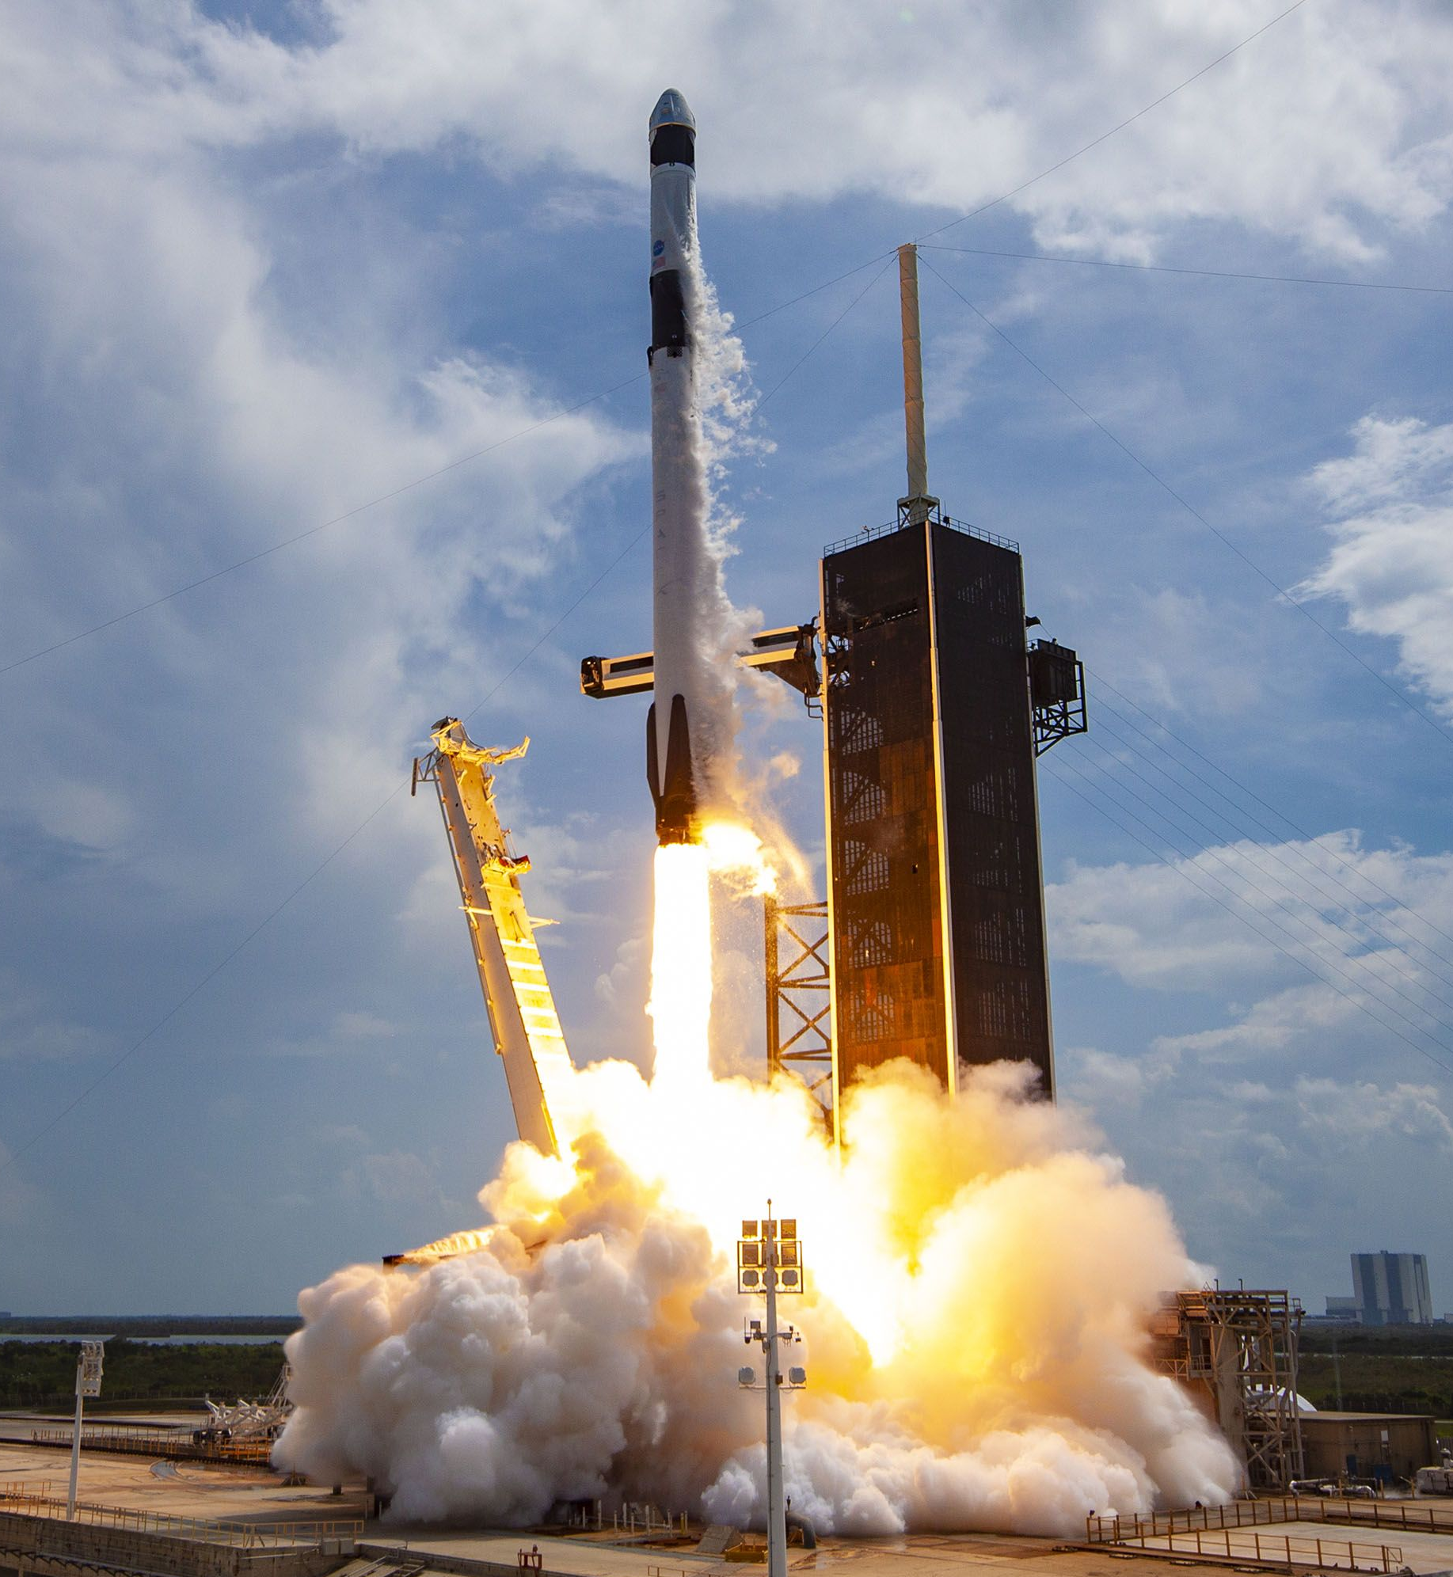
Introduction
SpaceX offers Falcon 9 rocket launches with a cost of 62 million dollars while other providers cost upward of 165 million dollars each. A significant amount of the savings is due to SpaceX's ability to reuse the first stage.
In this context, the main goal of the present study is to predict the first stage landing of the SpaceX Falcon 9 rocket launch by using a classification model in order to determine the cost of a launch.
Furthermore, it is also desirable to obtain other insights from the SpaceX Falcon 9 rocket launches.

Slide 6

Section 1

Slide 7
Methodology
Executive Summary
Python 3 and its libraries were used in the entire project.
First, data was collected through REST calls to the SpaceX API using Requests and by performing web scraping to the Wikipedia's article on List of Falcon 9 and Falcon Heavy launches using BeatifulSoup. Data covers a time period from 2010-04-06 to 2020-06-12.
Then, a process of data wrangling was performed using Pandas and Numpy in order to filter the data to the Falcon 9 launches only, imputing missing values with the mean, creating the landing outcome labels; as well as selecting the features for modeling and obtaining dummy variables for the categorical variables.
Next, an exploratory data analysis (EDA) was performed by means of visualization using Matplotlib and SQL.

Slide 8
Methodology
Executive Summary
After that, an interactive visual analysis using Folium and Plotly Dash was carried out.
Finally, a predictive analysis was performed by means of a Classification Model using Scipy and Scikit-learn. To do so:
Data was split in a training and test sets.
The model was built by using several machine learning techniques: Logistic Regression, Support Vector Machines (SVM), Decision Trees and K-Nearest Neighbors (KNN).
The models were tuned by using GridSearchCV, in which several parameters were tested, and the data was cross-validated in a 10-fold scheme.
The best model was selected based on the criteria of outcome of the confusion matrix, precision, recall, f1-score and accuracy.

Slide 9
Data Collection
Data sets were collected through SpaceX API and Web Scraping in Python 3 by using the libraries Requests, Pandas, Numpy, BeautifulSoup, among others.
SpaceX API
Web Scraping
Data sets
Figure 1. Data sources. Own elaboration.

Slide 10
Data Collection – SpaceX API
Set URL and GET Request
Response Decoding
Data Combination and Conversion to Dataframe
Functions Definition and API calls
Filtering (Falcon 9 only)
Missing Values Imputing (mean)
The purpose of this step was to make a get request to the SpaceX API and clean the requested data.
Link of the data source:
https://cf-courses-data.s3.us.cloud-object-storage.appdomain.cloud/IBM-DS0321EN-SkillsNetwork/datasets/API_call_spacex_api.json
GitHub URL:
https://github.com/DanielEduardoLopez/IBM-SpaceX/blob/main/1-Spacex-data-collection-api.ipynb
Figure 2. Data collection process for SpaceX API. Own elaboration.

Slide 11
Data Collection - Scraping
The purpose of this step was to extract the Falcon 9 launch records from Wikipedia.
Link of the data source:
https://en.wikipedia.org/wiki/List_of_Falcon\_9\_and_Falcon_Heavy_launches
GitHub URL:
https://github.com/DanielEduardoLopez/IBM-SpaceX/blob/main/2-Webscraping.ipynb
Set URL and GET Request
BeautifulSoup Object Creation
HTML Tables Parsing
Conversion to Pandas Dataframe
Figure 3. Data collection process for web scraping. Own elaboration.

Slide 12
Data Wrangling
Column Types Identification
Missing Values Identification
Number of Launches per Site
Number and occurrence of each orbit
Number and occurence of mission outcome per orbit type
Landing Outcome Label Creation
The purpose of this step was to find some patterns in the data and determine the label for training supervised models.
GitHub URL:
https://github.com/DanielEduardoLopez/IBM-SpaceX/blob/main/3-Spacex_Data_wrangling.ipynb
Figure 4. Data wrangling process. Own elaboration.

Slide 13
EDA with Data Visualization
The purpose of this step was to perform Exploratory Data Analysis with Pandas and Matplotlib.
The following charts were plotted:
Scatter Plot of "Flight Number" vs. "Payload Mass": To assess the likelihood of the first stage return in function of the Payload Mass and the Flight Number.
Scatter Plot of "Flight Number" vs. "Launch Site": To assess the relationship among Launch Site, Flight Number, and the first stage return.
Scatter Plot of "Payload Mass" vs. "Launch Site": To assess the relationship among Launch Site, Payload Mass and the first stage return.

Slide 14
EDA with Data Visualization
Bar chart of the "Orbit" "Success Rate": To assess the sucess rate of each orbit.
Scatter Plot of "Flight Number" vs. "Orbit": To assess the relationship among Flight Number, Orbit, and the first stage return.
Scatter Plot of "Payload Mass" vs. "Orbit": To assess the relationship among Payload Mass, Orbit, and the first stage return.
Line Chart of "Payload Mass" vs. "Orbit": To visualize the launch success yearly trend.
GitHub URL: https://github.com/DanielEduardoLopez/IBM-SpaceX/blob/main/5-EDA_dataviz.ipynb

Slide 15
Feature Engineering
In addition, Feature Engineering was carried out to select the features that were used in the classification model. The following ones were selected:
'FlightNumber', 'PayloadMass', 'Orbit', 'LaunchSite', 'Flights', 'GridFins', 'Reused', 'Legs', 'LandingPad', 'Block', 'ReusedCount', 'Serial'
Then, dummy variables were created for the categorical variables Orbits, LaunchSite, LandingPad, and Serial using the get_dummies() function.
Finally, the whole dataset was casted to float64 datatype.
GitHub URL: https://github.com/DanielEduardoLopez/IBM-SpaceX/blob/main/5-EDA_dataviz.ipynb

Slide 16
EDA with SQL
Furthermore, the following SQL queries were performed after loading the dataset into a corresponding table in a database using the libraries Sqlite3 and Sqlalchemy:
SELECT Launch_Site, COUNT(Launch_Site) AS Count FROM SPACEXTBL GROUP BY Launch_Site;
SELECT * FROM SPACEXTBL WHERE Launch_Site LIKE 'CCA%' LIMIT 5;
SELECT SUM(PAYLOAD_MASS__KG_) FROM SPACEXTBL WHERE Customer = 'NASA (CRS)';
SELECT AVG(PAYLOAD_MASS__KG_) FROM SPACEXTBL WHERE Booster_Version LIKE 'F9 v1.1%';
SELECT MIN(Date) FROM SPACEXTBL WHERE "Landing _Outcome" = 'Success (ground pad)';

Slide 17
EDA with SQL
SELECT Booster_Version FROM SPACEXTBL WHERE "Landing _Outcome" = 'Success (drone ship)' AND PAYLOAD_MASS__KG_ > 4000 AND PAYLOAD_MASS__KG_ < 6000;
SELECT Mission_Outcome, COUNT(Payload) FROM SPACEXTBL GROUP BY Mission_Outcome;
SELECT Booster_Version FROM SPACEXTBL WHERE PAYLOAD_MASS__KG_ = (SELECT MAX(PAYLOAD_MASS__KG_) FROM SPACEXTBL);
SELECT SUBSTR(Date,1,4) AS Year, COUNT("Landing _Outcome") AS Successful_landing_outcomes FROM SPACEXTBL WHERE DATE > '2010-06-04' AND DATE < '2017-03-20' AND "Landing _Outcome" LIKE 'Success%' GROUP BY SUBSTR(Date,1,4) ORDER BY SUBSTR(Date,1,4) DESC;

Slide 18
EDA with SQL
SELECT DISTINCT (CASE when SUBSTR(Date, 6, 2) = '01' then 'January' when SUBSTR(Date, 6, 2) = '02' then 'February' when SUBSTR(Date, 6, 2) = '03' then 'March' when SUBSTR(Date, 6, 2) = '04' then 'April' when SUBSTR(Date, 6, 2) = '05' then 'May' when SUBSTR(Date, 6, 2) = '06' then 'June' when SUBSTR(Date, 6, 2) = '07' then 'July' when SUBSTR(Date, 6, 2) = '08' then 'August' when SUBSTR(Date, 6, 2) = '09' then 'September' when SUBSTR(Date, 6, 2) = '10' then 'October' when SUBSTR(Date, 6, 2) = '11' then 'November' when SUBSTR(Date, 6, 2) = '12' then 'December' END) AS Month, "Landing _Outcome", Booster_Version, Launch_Site FROM SPACEXTBL WHERE SUBSTR(Date,1,4)='2015' AND "Landing _Outcome" = 'Failure (drone ship)’;
GitHub URL: https://github.com/DanielEduardoLopez/IBM-SpaceX/blob/main/4-EDA_sql_sqllite.ipynb

Slide 19
Build an Interactive Map with Folium
An Interactive Map with the Folium library was created, and the following maps objects were created and added to the map:
Markers and circles for all launch sites: To visualize the location of the launch sites and assess their characteristics.
Marker Clusters for success/failed launches for each site: To assess if there was a relationship among the launch sites and their success/fail missions.
Markers and lines between a launch site to its proximities: To assess the characteristics of the proximities to the launch sites.
GitHub URL: https://github.com/DanielEduardoLopez/IBM-SpaceX/blob/main/6-Folium_Launch_site_location.ipynb

Slide 20
Build a Dashboard with Plotly Dash
An Interactive Dashboard with the Plotly and Dash libraries was built, and the following plots/graphs and interactions were added to the dashboard:
Dropdown: In order to enable the Launch Site selection for the user.
Pie chart: To show the Total Success Launches by Site.
Range Slider: To enable the Payload Mass selection.
Scatter Plot: To show the relationship among Payload Mass and mission outcomes for the selected Sites.
GitHub URL:
https://github.com/DanielEduardoLopez/IBM-SpaceX/blob/main/7-spacex_dash_app.py
https://github.com/DanielEduardoLopez/IBM-SpaceX/blob/main/8-SpaceX_Dashboard.ipynb

Slide 21
Predictive Analysis (Classification)
Data Standarization (Standard Scaler)
Creation of logistic regression, SVM, decision tree and KNN objects.
Dataset split into training and test data.
Accuracy calculation (score method)
Plot of confusion matrix
Identification of best parameters with GridSearchCV.
Selection of best classification model with classificaction report.
The purpose of this step was to build a Classification model for predicting the landing of the first phase; as well as finding the best hyperparameters and the best model.
GitHub URL: https://github.com/DanielEduardoLopez/IBM-SpaceX/blob/main/9-SpaceX_Machine%20Learning%20Prediction.ipynb
Figure 5. Predictive analysis process. Own elaboration.

Slide 22
Results
Table 3. Orbit Type Counting and Success Rate.
Exploratory data analysis results
Orbit | Count | Success Rate
GTO | 27 | 51.85%
ISS | 21 | 61.90%
VLEO | 14 | 85.71%
PO | 9 | 66.67%
LEO | 7 | 71.43%
SSO | 5 | 100.00%
MEO | 3 | 66.67%
ES-L1 | 1 | 100.00%
HEO | 1 | 100.00%
SO | 1 | 0.00%
GEO | 1 | 100.00%
Table 1. Launch Site Counting and Success Rate.
Launch Site | Count | Success Rate
CCAFS SLC 40 | 55 | 60.00%
KSC LC 39A | 22 | 77.27%
VAFB SLC 4E | 13 | 76.92%
Table 2. Successful Landing Counting from 2015-2017.
Year | Successful Landing Outcomes
2017 | 4
2016 | 5
2015 | 1

Slide 23
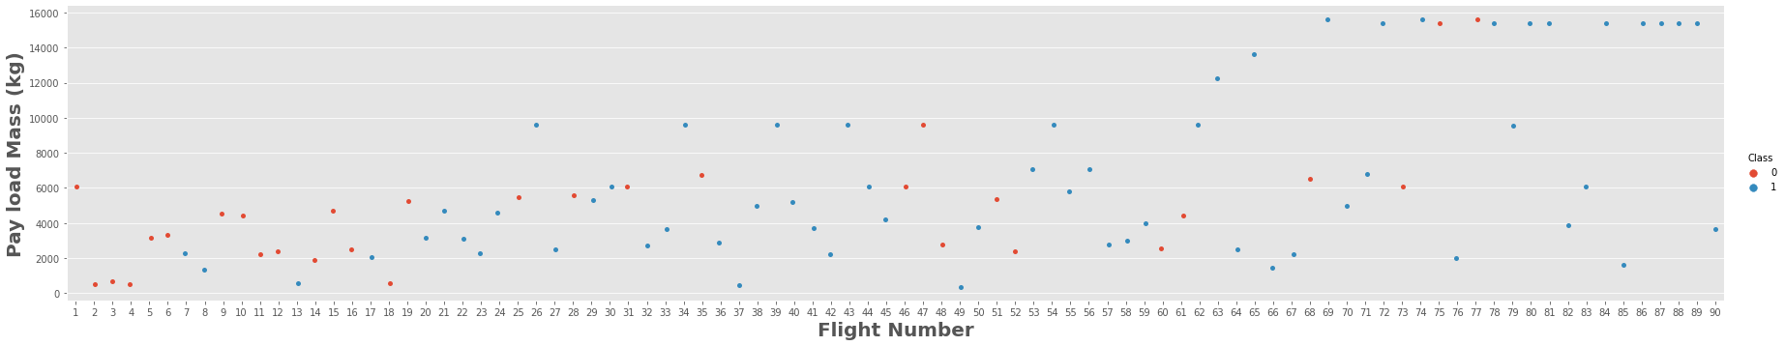
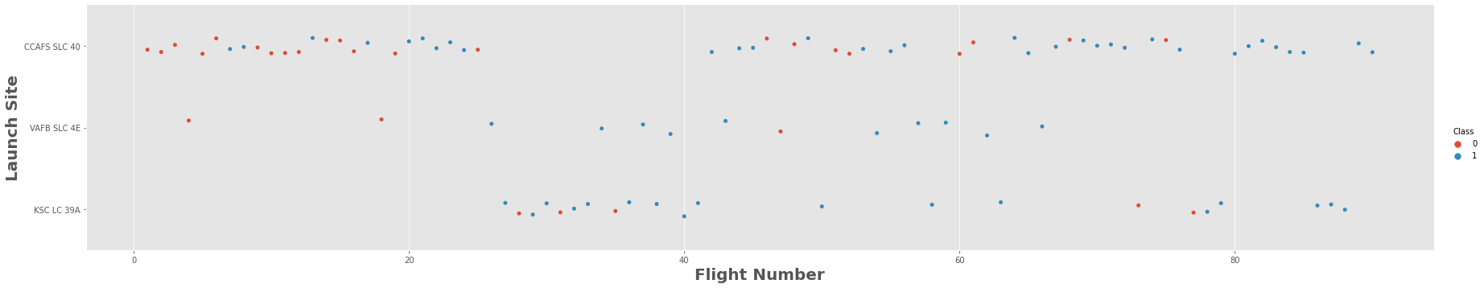
Results
Exploratory data analysis results
Figure 6. Flight Number vs. Payload Mass. Own elaboration.
Figure 7. Flight Number vs. Launch Site. Own elaboration.

Slide 24
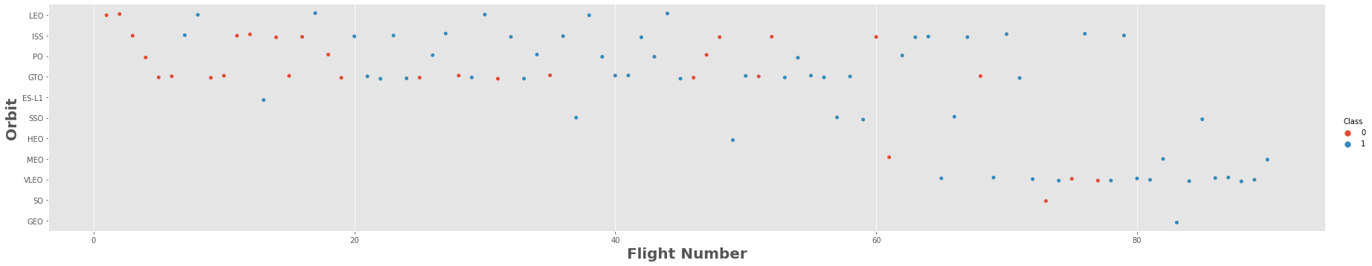
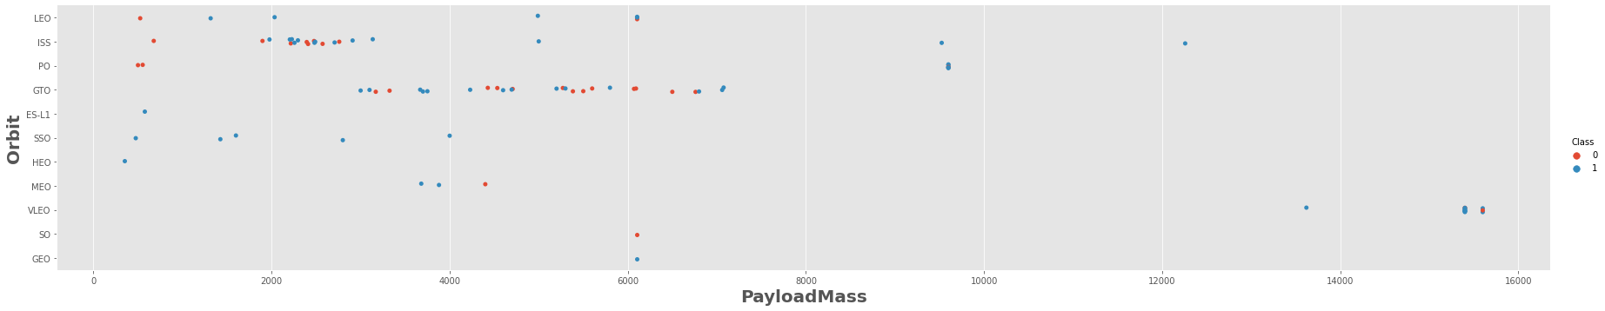
Results
Exploratory data analysis results
Figure 8. Flight Number vs. Orbit. Own elaboration.
Figure 9. Payload Mass vs. Orbit. Own elaboration.

Slide 25
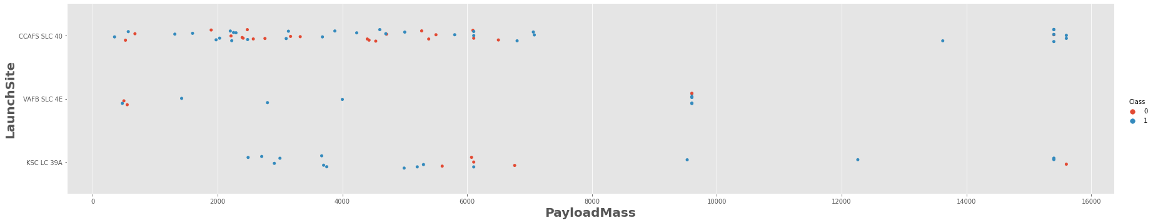
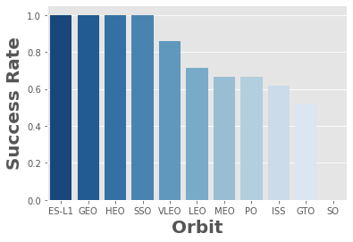
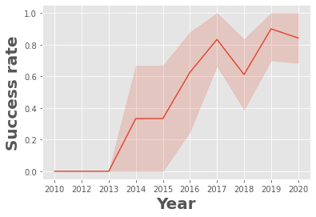
Results
Exploratory data analysis results
Figure 10. Payload Mass vs. Launch Site. Own elaboration.
Figure 11. Orbit Success Rate. Own elaboration.
Figure 12. Success Rate Over Time. Own elaboration.

Slide 26
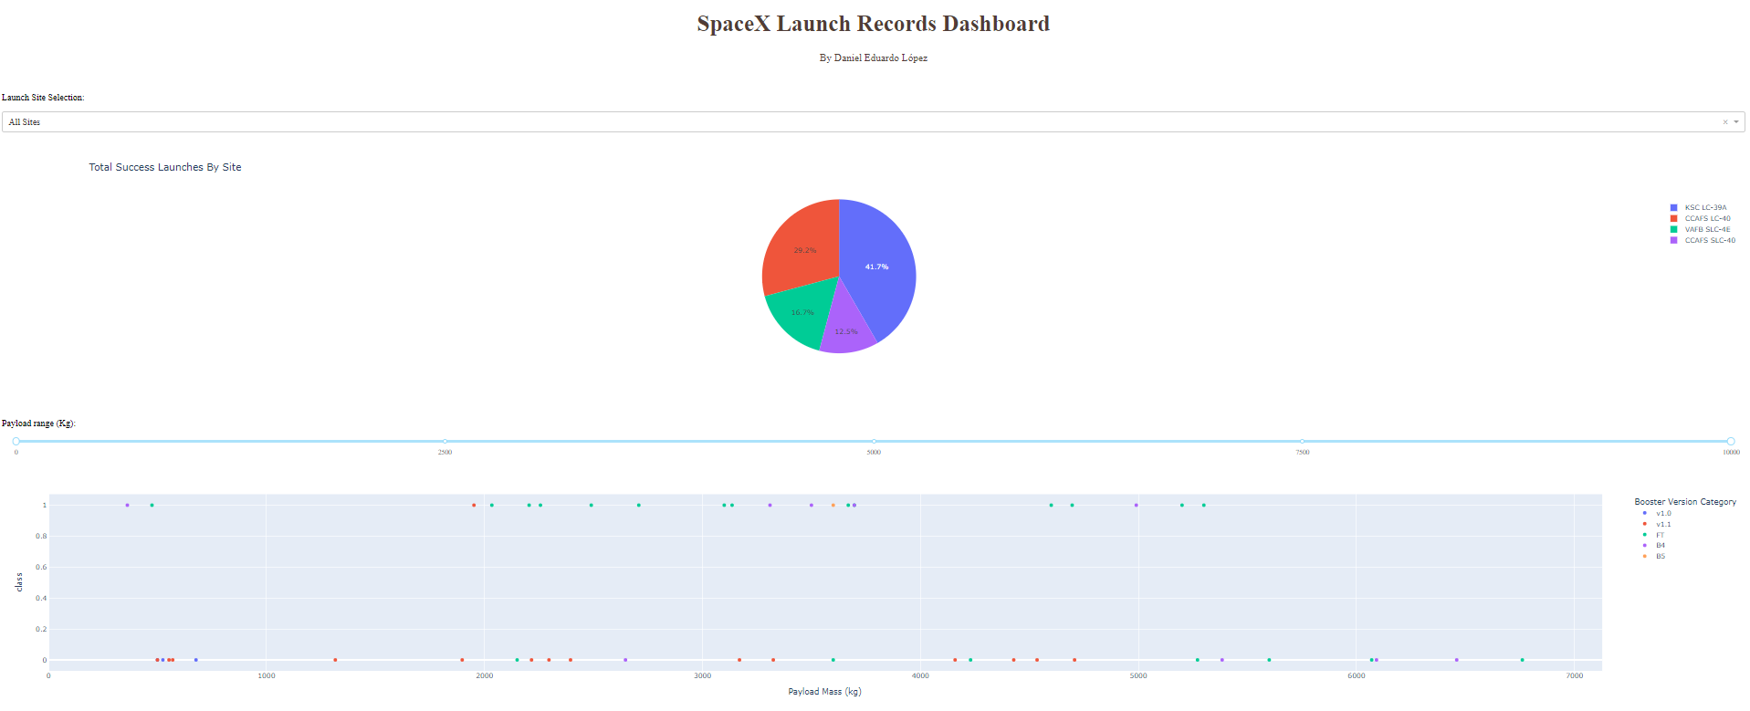
Results
Interactive analytics demo.
Figure 13. Dashboard overview. Own elaboration.

Slide 27
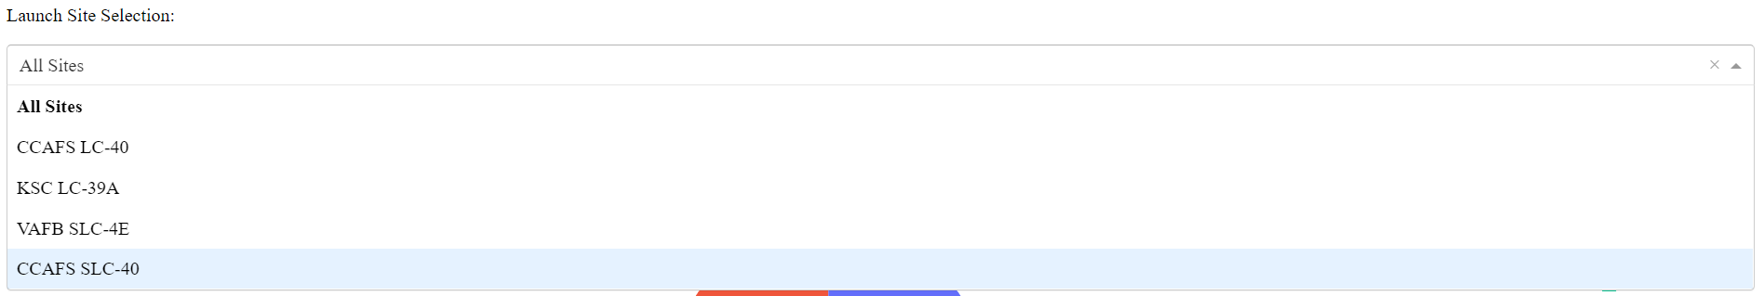
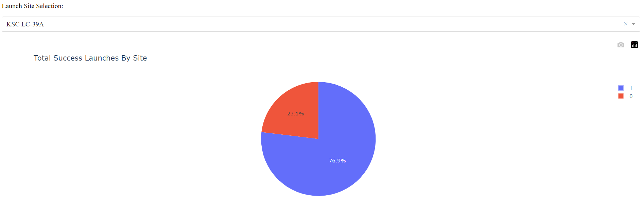
Results
Interactive analytics demo.
Figure 14. Dashboard's dropdown. Own elaboration.
Figure 15. Dashboard's Pie Chart with Success Rate per Site. Own elaboration.

Slide 28
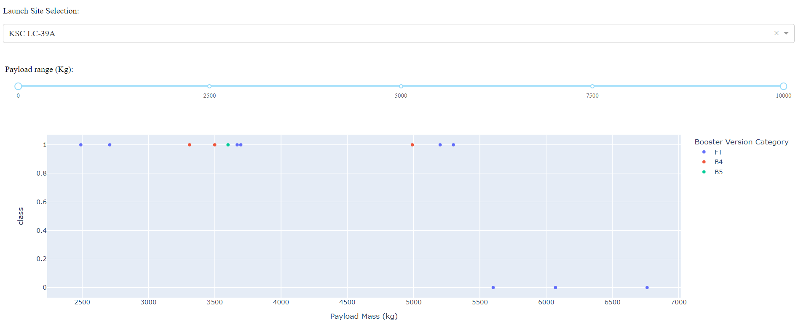
Results
Interactive analytics demo.
Figure 16. Dashboard's Scatter Plot of Payload Mass vs Class with Range Slider for Payload Mass. Own elaboration.

Slide 29
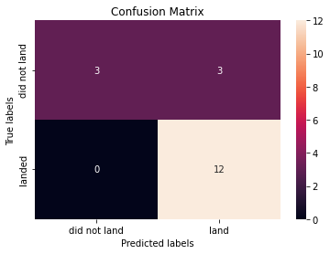
Results
Predictive analysis results
Figure 17. Logistic regression confusion matrix. Own elaboration.
Figure 18. SVM confusion matrix. Own elaboration.

Slide 30
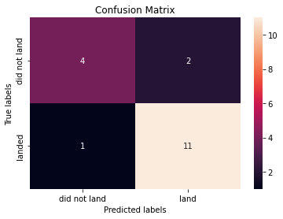
Results
Predictive analysis results
Figure 19. Decision trees confusion matrix. Own elaboration.
Figure 20. KNN confusion matrix. Own elaboration.

Slide 31
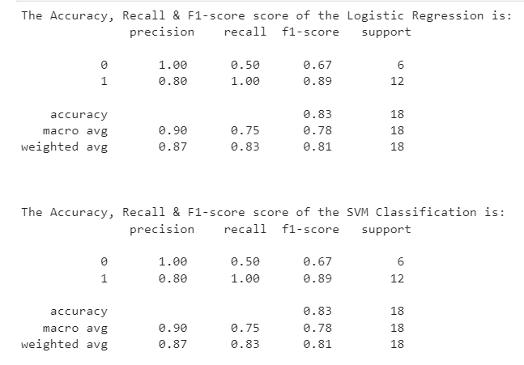
Results
Predictive analysis results
Figure 21. Logistic regression and SVM models classification reports. Own elaboration.

Slide 32
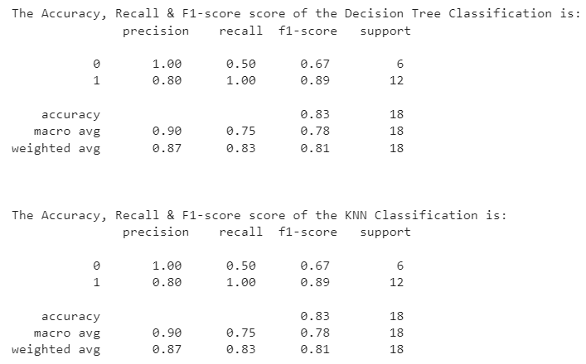
Results
Predictive analysis results
Figure 22. Decision trees and KNN models classification reports. Own elaboration.

Slide 33

Section 2

Slide 34
Flight Number vs. Launch Site
Figure 7. Flight Number vs. Launch Site. Own elaboration.
CCAFS SLC 40 is the most used Launch Site and the VAFB SLC-4E is the least used one.
The success rate has improved over the years as represented by the Flight number.
KSC LC-39A is the launch site with the highest number of successful missions.

Slide 35
Payload vs. Launch Site
Figure 10. Payload Mass vs. Launch Site. Own elaboration.
CCAFS SLC 40 and KSC LC-39A are used for a broad range of payload masses, from light to extra heavy ones.
VAFB SLC-4E is only used for light and medium payloads, which might explain why is the less used launch site.
The missions tend to be more successful with heavier payloads.

Slide 36
Success Rate vs. Orbit Type
ES-L1, GEO, HEO and SSO are the orbit types with the highest success rates (100%).
SO is the orbit type with the lowest success rate (0%).
The rest of the orbit types have a success rate ranging from 50% to 85%.
Figure 11. Orbit Success Rate. Own elaboration.

Slide 37
Flight Number vs. Orbit Type
Figure 8. Flight Number vs. Orbit. Own elaboration.
LEO, ISS, PO, GTO and VLEO are the most common orbit types.
EO, PO, GTO and VLEO are less common in recent flight numbers.
VLEO is the most common orbit type in recent flight numbers.
Earlier flight numbers show a tendency to fail regardless of the orbit type.

Slide 38
Payload vs. Orbit Type
Figure 9. Payload Mass vs. Orbit. Own elaboration.
Heavier payloads are selected for VLEO, IS and PO orbit types and have a high rate of success.
It appears that ES-L1, SSO and HEO are used with light payloads (from 0 to 4000 kg) and have a high rate of success.
The rest of the orbit types are used with light and medium payloads (from 0 to 7000 kg).

Slide 39
Launch Success Yearly Trend
Definitely, the launch success rate have improved over the years.
In particular, the success rate have improved since 2013, from 0% to an 80% in 2017.
Since 2017, it appears that the success rate has stabilized in about 80%.
Figure 12. Success Rate Over Time. Own elaboration.

Slide 40
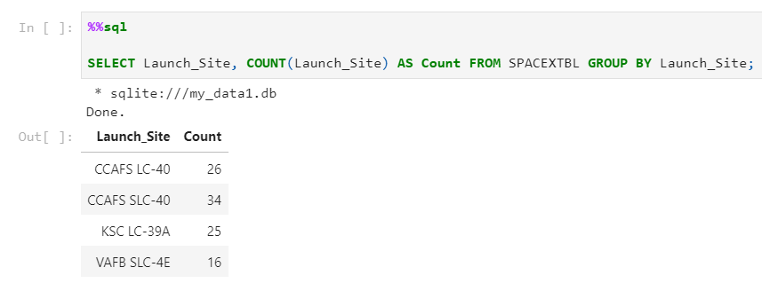
All Launch Site Names
CCAFS SLC-40 is the most used Launch Site and the VAFB SLC-4E is the least used.
Figure 23. SQL Query with Launch Site Count. Own elaboration.

Slide 41
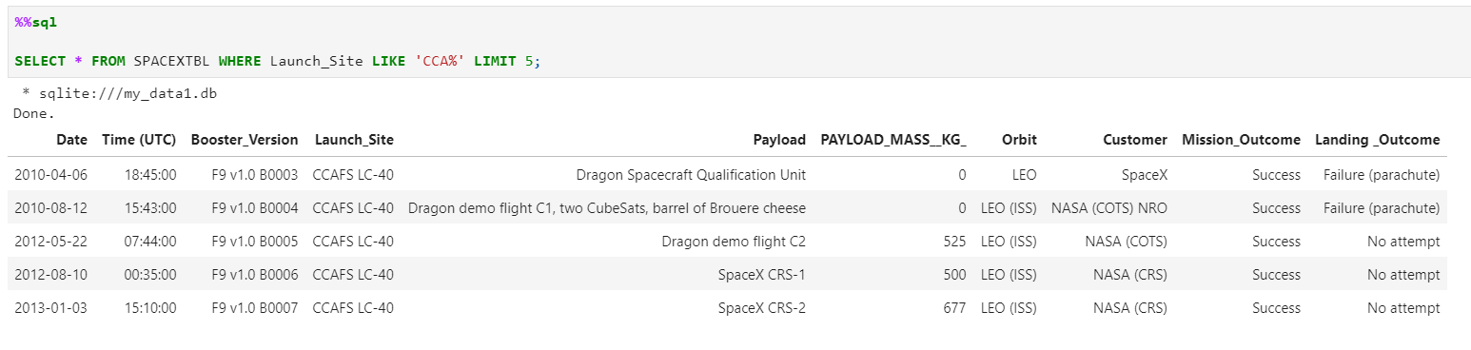
Launch Site Names Begin with 'CCA'
The launch site whose name begins with the string 'CCA' is CCAFS SLC-40.
Figure 24. SQL Query with Launch Site whose name begins with 'CCA'. Own elaboration.

Slide 42
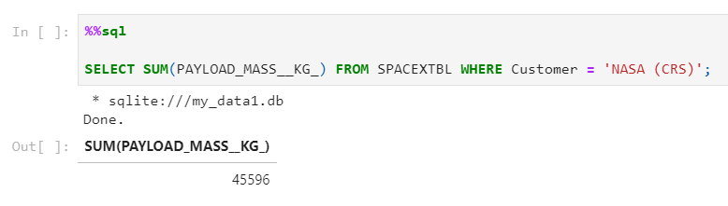
Total Payload Mass
The total payload carried by boosters from NASA is 45 596 kg.
Figure 25. SQL Query with Total Payload Carried by Booster from NASA. Own elaboration.

Slide 43
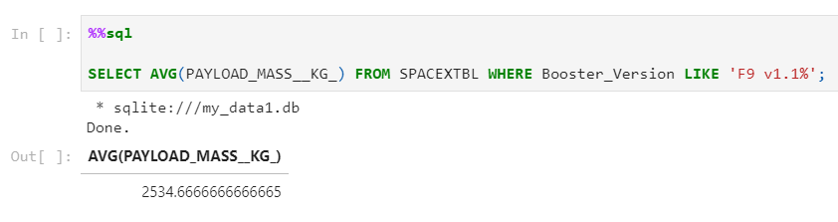
Average Payload Mass by F9 v1.1
The average payload mass carried by booster version F9 v1.1 is 2534.66 kg, which is in the range of the light payloads.
Figure 26. SQL Query with average payload mass carried by booster version F9 v1.1. Own elaboration.

Slide 44
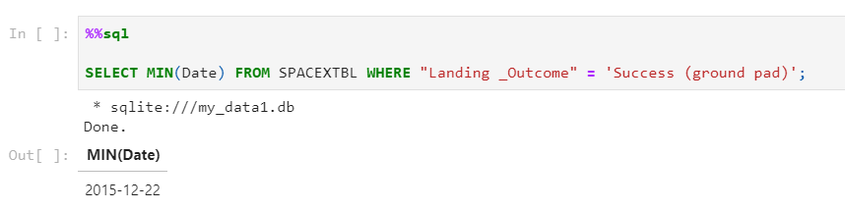
First Successful Ground Landing Date
The first successful landing outcome on ground pad was achieved on 2015-12-22.
Figure 27. SQL Query with first successful landing outcome on ground pad. Own elaboration.

Slide 45
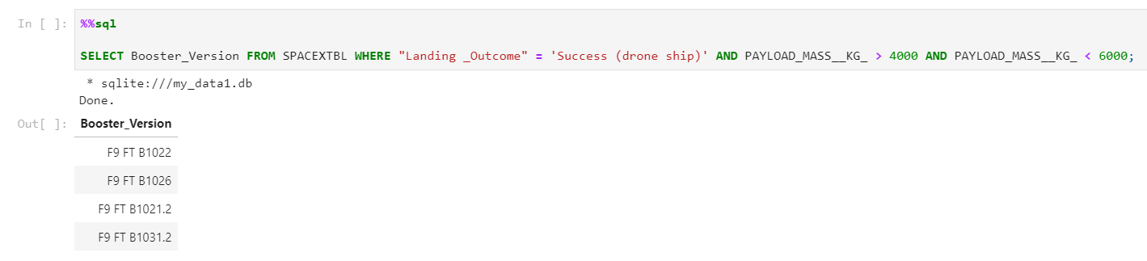
Successful Drone Ship Landing with Payload between 4000 and 6000
The names of boosters which have successfully landed on drone ship and had payload mass greater than 4000 but less than 6000 are F9 FT B1022, F9 FT B1026, F9 FT B1021.2 and F9 FT B1031.2.
Figure 28. SQL Query with names of boosters which have successfully landed on drone ship and had payload mass greater than 4000 but less than 6000. Own elaboration.

Slide 46
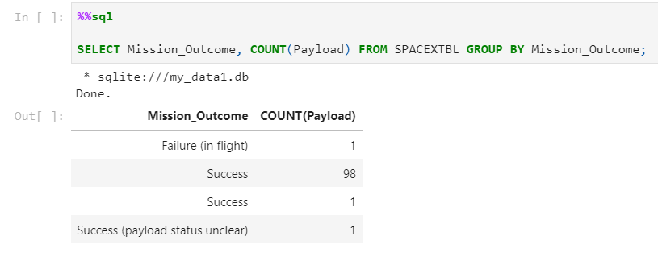
Total Number of Successful and Failure Mission Outcomes
The total number of successful and failure mission outcomes are 100 and 1, respectively.
Figure 29. SQL Query with total number of successful and failure mission outcomes. Own elaboration.

Slide 47
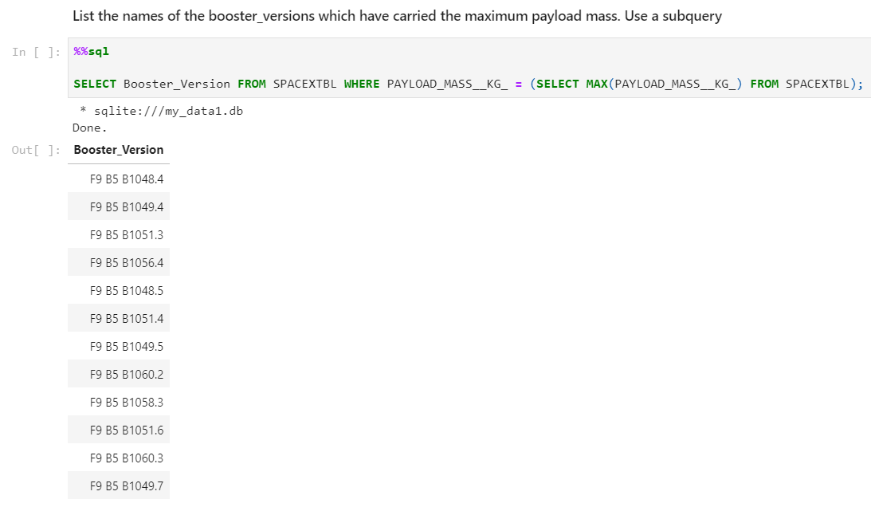
Boosters Carried Maximum Payload
The names of the booster which have carried the maximum payload mass are shown in the image below:
Figure 30. SQL Query with names of the booster which have carried the maximum payload mass. Own elaboration.

Slide 48
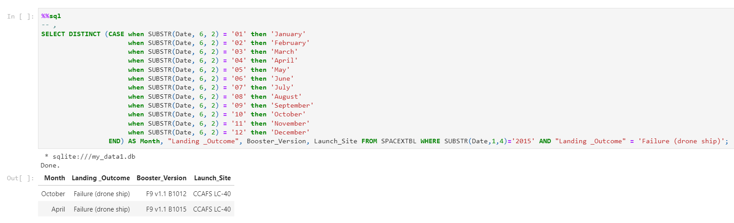
2015 Launch Records
The failed landing outcomes in drone ship, their booster versions, and launch site names for in year 2015 happened in October and April.
Figure 31. SQL Query with failed landing outcomes in drone ship, their booster versions, and launch site names for in year 2015. Own elaboration.

Slide 49
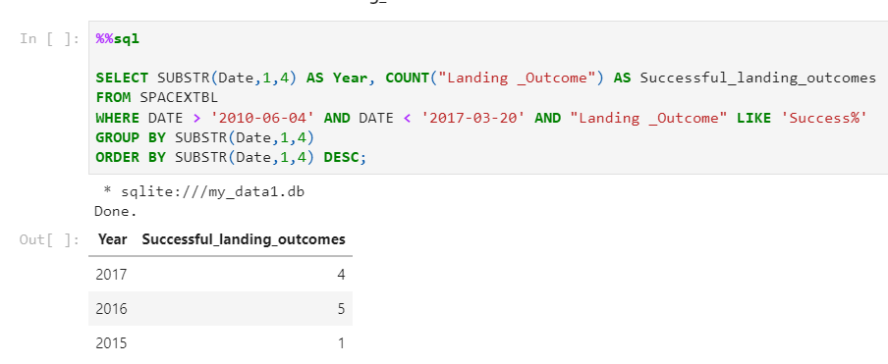
Rank Landing Outcomes Between 2010-06-04 and 2017-03-20
The rank of count of landing outcomes (such as Failure (drone ship) or Success (ground pad)) between the date 2010-06-04 and 2017-03-20, in descending order is shown in the image below:
Figure 32. SQL Query with rank of count of landing outcomes between the date 2010-06-04 and 2017-03-20. Own elaboration.

Slide 50

Section 3

Slide 51
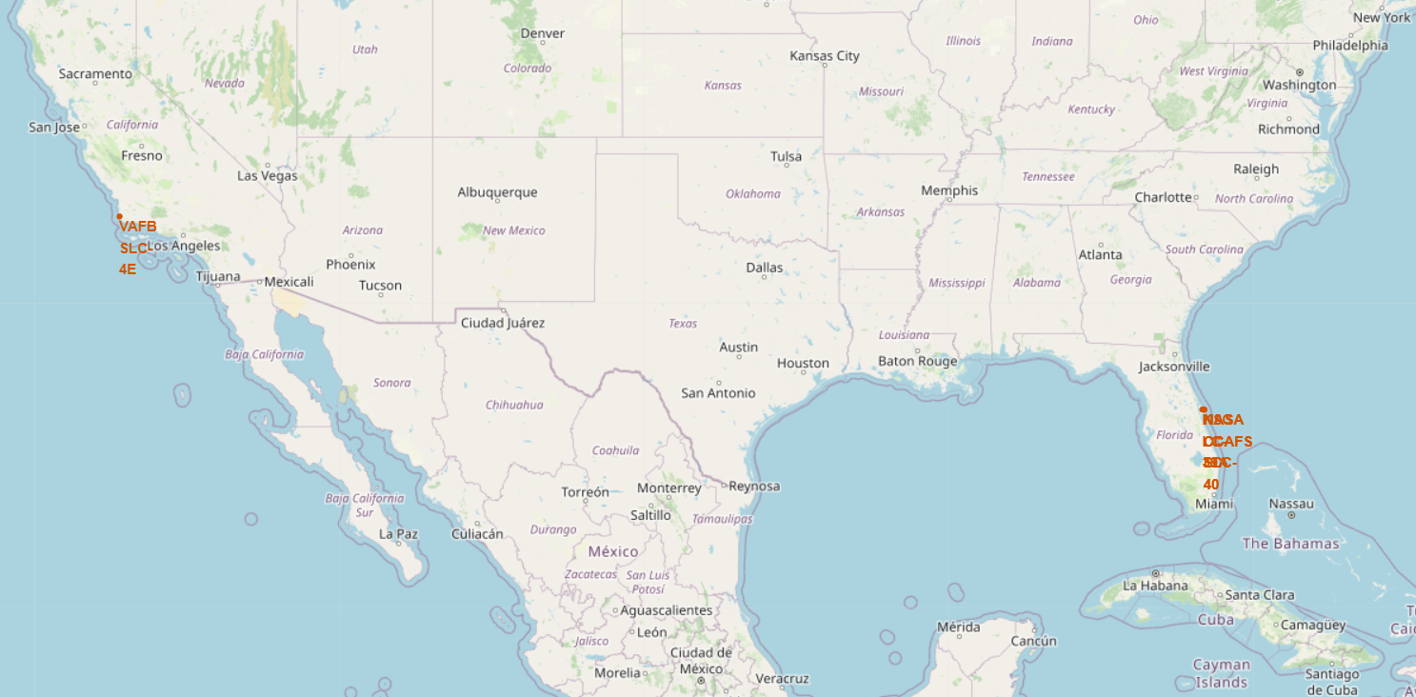
Launch Sites Localization
Launch sites are located on the coasts and close to the Ecuador.
Figure 33. Map with the localization of launch sites. Own elaboration.

Slide 52
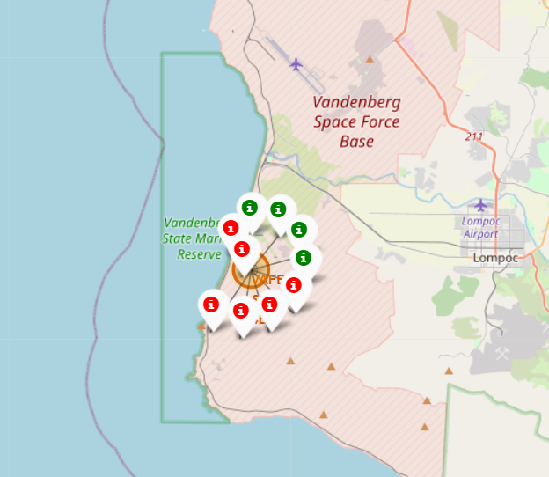
Launch Outcomes Per Launch Site
The Vanderberg (VAFB SLC-4E) Launch Site is the least used and its number of successful landings is fairly low.
Figure 34. Map with the localization of VAFB SLC-4E launch site and marks of successful and unsuccessful landings. Own elaboration.

Slide 53
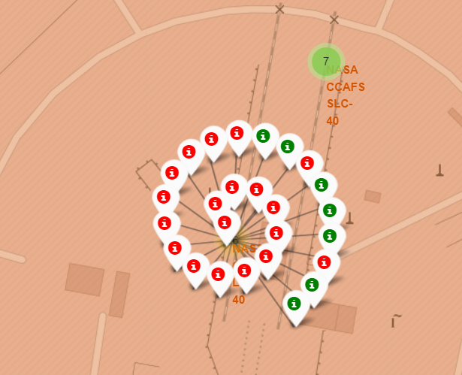
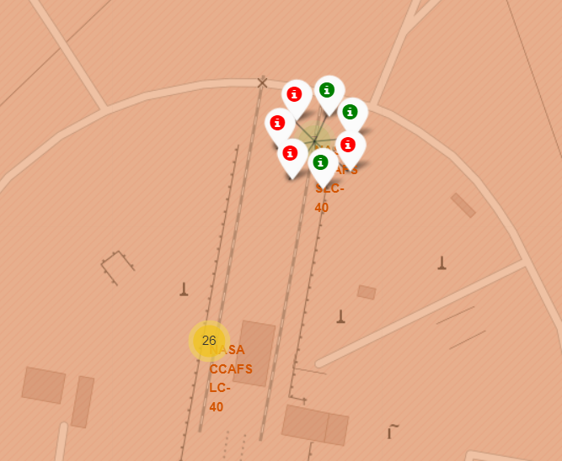
Launch Outcomes Per Launch Site
The Cape Canaveral (CCAFS LC-40 and CCAFS SLC-40) is the most used Launch Site, even though its number of failed landings is slightly superior to the its number of successful landings.
Figure 35. Map with the localization of CCAFS LC-40 and CCAFS SLC-40 launch site and marks of successful and unsuccessful landings. Own elaboration.

Slide 54
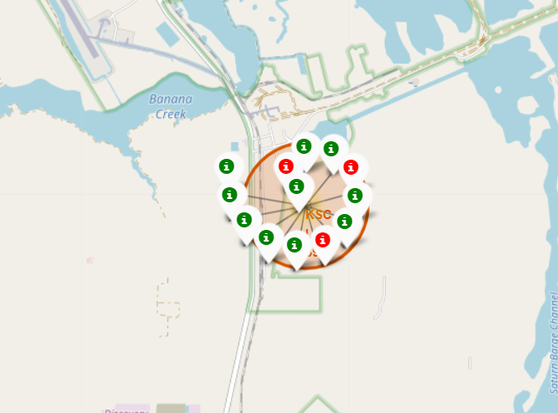
Launch Outcomes Per Launch Site
The Kennedy Space Center (KSC LC-39A) has the highest number of successful missions. Nonetheless, it is not the most used Launch Site.
Figure 36. Map with the localization of KSC LC-39A launch site and marks of successful and unsuccessful landings. Own elaboration.

Slide 55
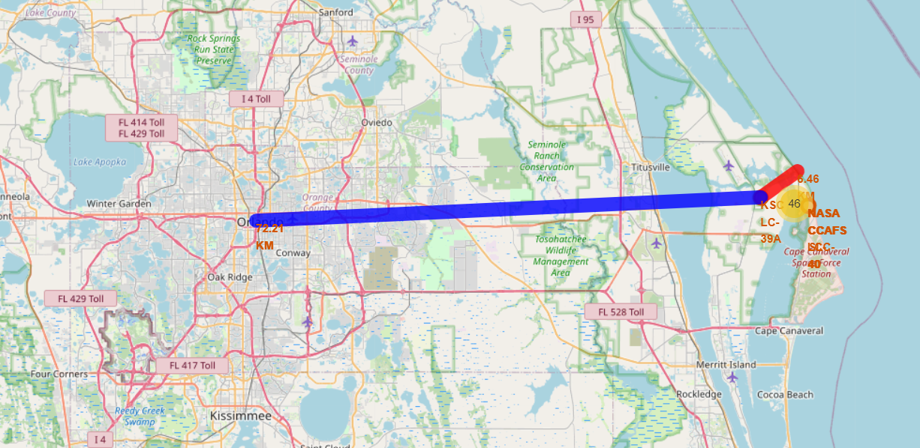
KSC LC-39A distance to the sea and Orlando, FL.
KSC LC-39A is 6.46 KM far from the Atlantic Sea, and 72.21 KM far from Orlando, FL.
Figure 37. Map with the localization of KSC LC-39A launch site and distances to the sea and Orlando, FL. Own elaboration.

Slide 56

Section 4

Slide 57
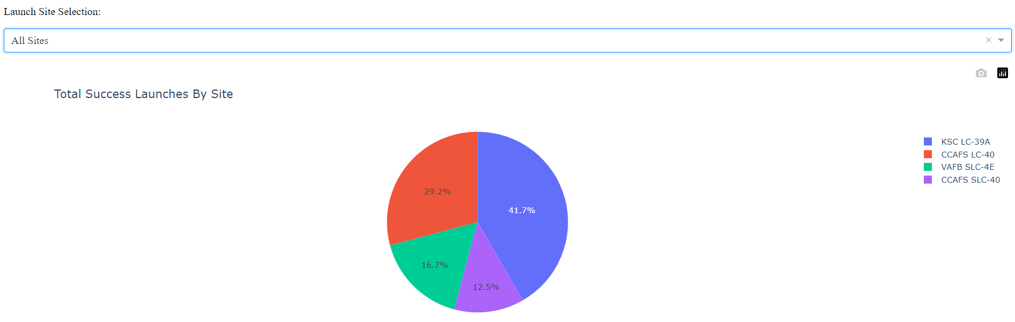
Launch Success Per Site
KSC LC-39A has the highest success launch rates, while VAFB SLC-4E holds the lowest. It is important to note that CCAFS LC-40 and CCAFS SLC-40 refer to the same facility.
Figure 38. Launch Success Per Site in Dashboard. Own elaboration.

Slide 58
Highest Launch Success Ratio
The Highest Launch Success Ratio is hold by the KSC LC-39A launch site, with a 76.9% of success and only 23.1% of failure.
Figure 39. Launch Success for KSC LC-39A in Dashboard. Own elaboration.

Slide 59
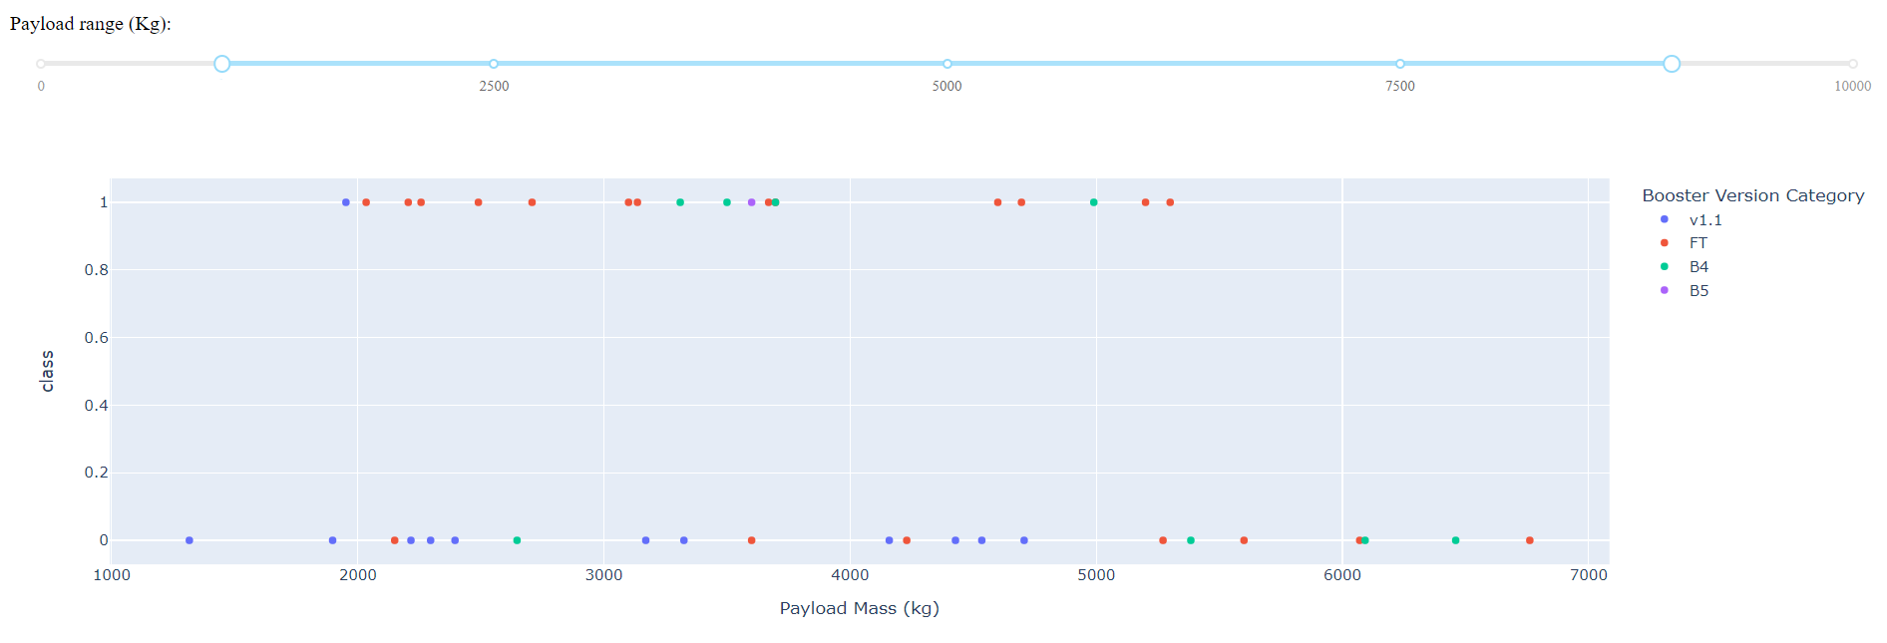
Payload vs. Launch Outcome
The Payload vs. Launch Outcome allowed to identify the payload ranges with the highest and the lowest success rates as well as the more successful F9 Booster versions (see next slides).
Figure 40. Dashboard's Scatter Plot of Payload Mass vs Class with Range Slider for Payload Mass 2. Own elaboration.

Slide 60
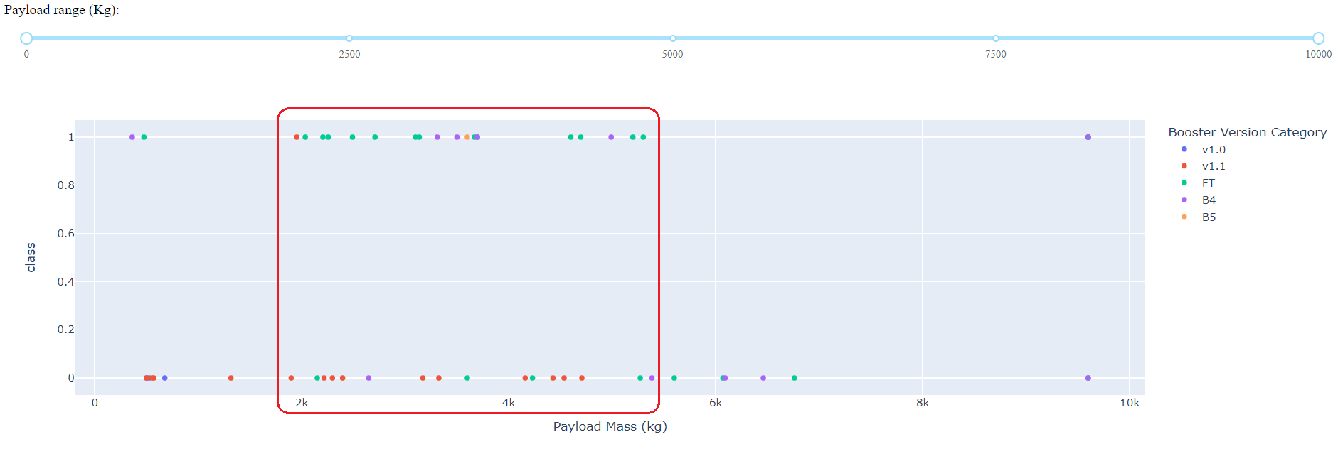
Payload vs. Launch Outcome
Which payload range(s) has the highest launch success rate? From 1952 kg to 5300 kg.
Figure 41. Payload range with the highest launch success rate. Own elaboration.

Slide 61
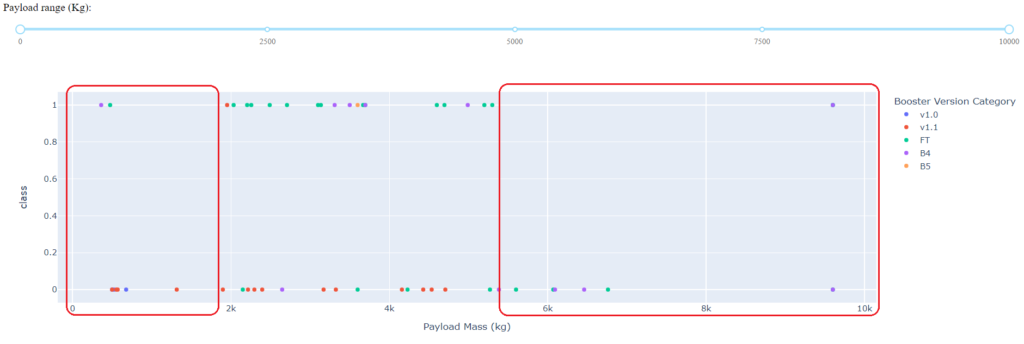
Payload vs. Launch Outcome
Which payload range(s) has the lowest launch success rate? Below 1952 kg and above 5300 kg.
Figure 42. Payload ranges with the lowest launch success rate. Own elaboration.

Slide 62
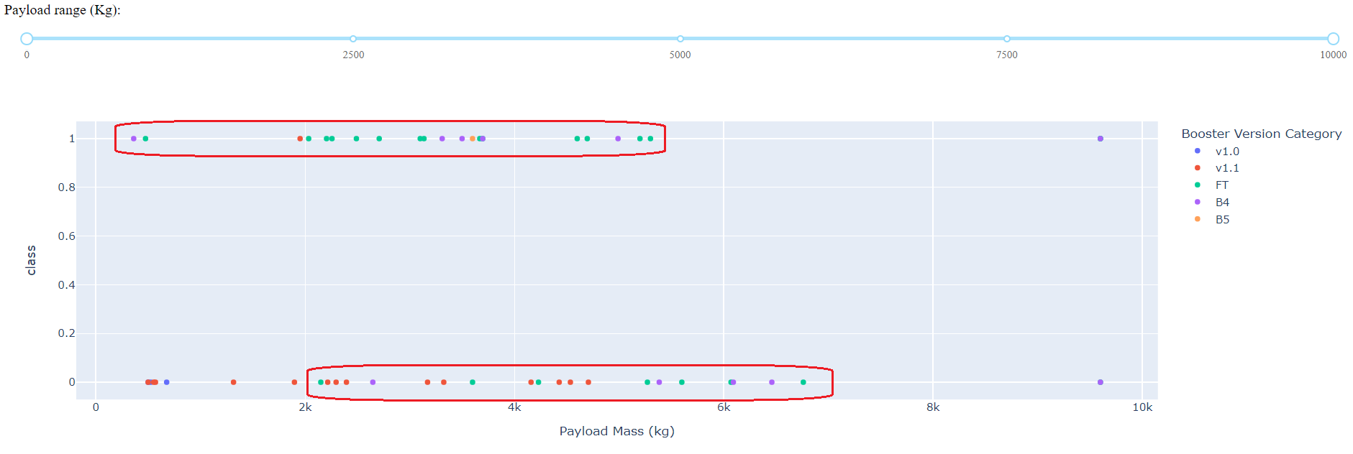
Best Booster versions
Which F9 Booster version (v1.0, v1.1, FT, B4, B5, etc.) has the highest launch success rate? The FT and the B5 Booster versions.
Figure 43. F9 Booster versions with the highest launch success rate. Own elaboration.

Slide 63

Section 5

Slide 64
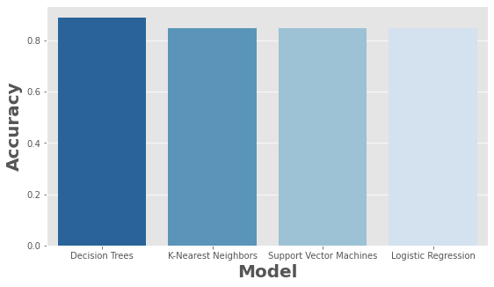
Classification Accuracy
The model with the highest classification accuracy was the one built with Decision Trees with an accuracy of 88.9%, when fitted with the best parameters:
{'criterion': 'gini', 'max_depth': 2, 'max_features': 'sqrt', 'min_samples_leaf': 1, 'min_samples_split': 2, 'splitter': 'best'}
Figure 44. Accuracy of the built classification models. Own elaboration.

Slide 65
Confusion Matrix
The confusion matrix suggests that the built model is better at predicting successful landings than unsuccessful landings.
So, there is room for improvement in terms of reducing both false positives and false negatives.
In spite of the above, this results suggest that, indeed, most of the launches from SpaceX will land successfully.
Figure 19. Decision trees confusion matrix. Own elaboration.

Slide 66
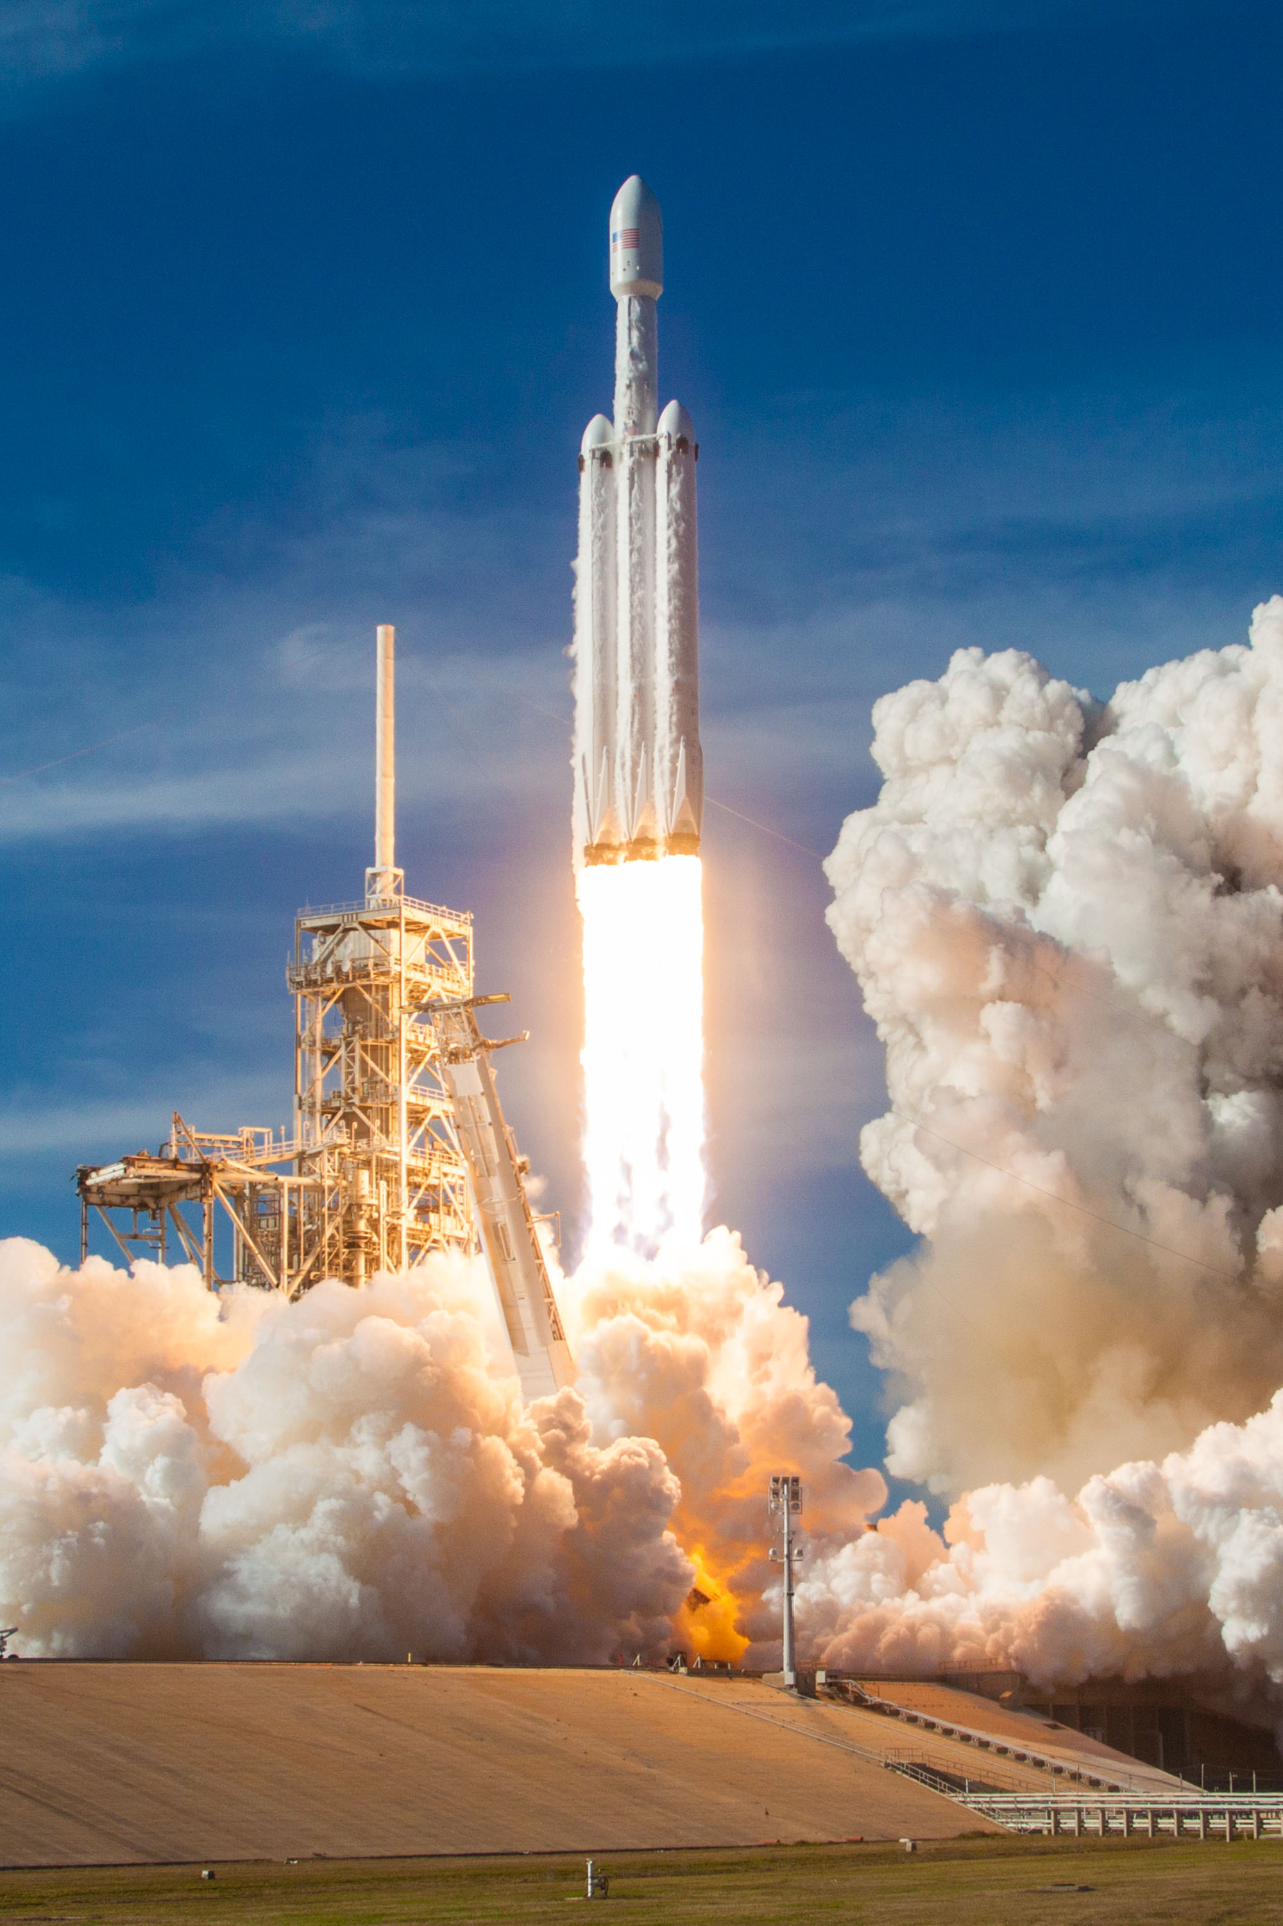
Conclusions
Firstly, a classification model using Decision Trees was developed with a precision of 88.9% and whose outcome indicates that most of the launches from SpaceX will land successfully.
On the other hand, analysis from the historical launching data suggests that SpaceX has gotten better at launching and its success rate has stabilized since 2017 in about 80%.
Thus, the present study suggests that the cost of the Falcon 9 rocket launches should be set at 62 million dollars, as stated by SpaceX.

Slide 67
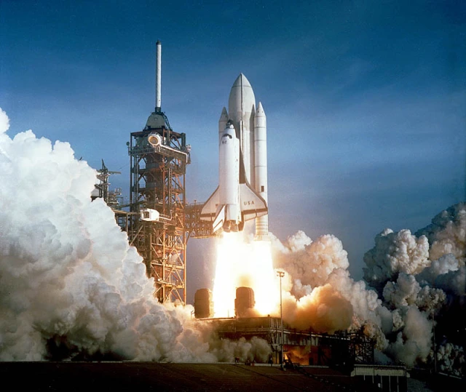
Conclusions
Other insights obtained from the present analysis were:
KSC LC-39A is the launch site with the highest number of successful missions and VAFB SLC-4E is the one with the lowest.
ES-L1, GEO, HEO and SSO are the orbit types with the highest success rates (100%) but with a small number of missions. On the other hand, VLEO is the most common orbit type in recent years.
The payload range with the highest launch success rate is from 1952 kg to 5300 kg.
FT and B5 are the booster versions with the highest launch success rate.

Slide 68
Appendix
Data set created from the calls to API SpaceX:
https://github.com/DanielEduardoLopez/IBM-SpaceX/blob/main/dataset_part_1_DEL.csv
Data set created from the web scraping to Wikipedia's article on List of Falcon 9 and Falcon Heavy launches:
https://github.com/DanielEduardoLopez/IBM-SpaceX/blob/main/spacex_web_scraped.csv
Data set created after Data wrangling:
https://github.com/DanielEduardoLopez/IBM-SpaceX/blob/main/dataset_part_2_DEL.csv
Dataset created after the Feature Engineering process:
https://github.com/DanielEduardoLopez/IBM-SpaceX/blob/main/dataset_part_3_DEL.csv

Slide 69


